Slide 1
Self-made enhancements
March 2021

Slide 2
Agenda
Why this is benefitial
Security, legal and IT assessment
How it works

Slide 3
Established new technique for customizing UI of Saba and EdCast
Previously, we were dependant on vendor's mercy
Now, we can act independently
Pros:
Vendor does implementation and continuous testing
New releases are tested by vendor to not break previous changes
Cons:
Long waiting time for changes
High effort to convince vendor
Vendor only implements changes if beneficial for many customers
Limitations often lead to not-ideal and expensive work-arounds
Pros:
Less dependent on vendor
Much faster results – POC within days instead of months
Avoid work-arounds, better learner value faster
More portable and more secure than external solutions (eg WalkMe)
Can replace some of the current WalkMe use cases
Cons:
BCG resource needs to do development and continuous testing for new releases
Adjustments might be necessary over time
Not everything can be done with this method
Legal limits need to be confirmed
Not possible to do changes within native apps (eg EdCast or Saba) – but still works on mobile browsers

Slide 4
Agenda
Why this is benefitial
Security, legal and IT assessment
How it works

Slide 5
Summary of assessments by security, legal and IT
Security assessment:
Discussed with Shaun Wityak (Security Architect) and Shouvik Kar (Pentester), see also email in next slides
From security perspective, there is no issue using this approach
Only requirement is that the code we inject is safe – we should always run it through Veracode to check for vulnerabilities
Legal assessment:
Discussed with procurement (Scott Reilly) who referred us to Aubrey Emory (legal counsel)
This is in a grey zone (very similar to AdBlockers or WalkMe), and EdCast acceptable use policy looks like this is not allowed. Another risk is, that the vendor might just turn off this feature if we don’t let them know beforehand. So she highly recommended to let them know and at least get an informal approval/acknowledgement through email.
Aubrey drafted email text for EdCast.
Kate sent email to Max Meadow (EdCast) and he confirmed that this is okay for us to use. (see next slide screenshot)
For EdCast we aim to also add it also to the next contract terms, since it is anyway due for extension.
Saba approval still pending – we have not asked them yet. Jean suggested to send email to Jake.
IT assessment:
Discussed with Scott Mirley, Siddharth Goel, Jean Whitney, Jung Choi
This is a good work-around to bridge the time until the vendor implements requested enhancements for us
We should make sure google tag manager accounts that have access to BCG assets are secured with 2-factor auth
Don’t make high-risk adjustments, ie the platforms should still remain usable even if the adjustments stop working (eg because of changes from vendor).
Use it sparely – don’t go crazy…

Slide 6
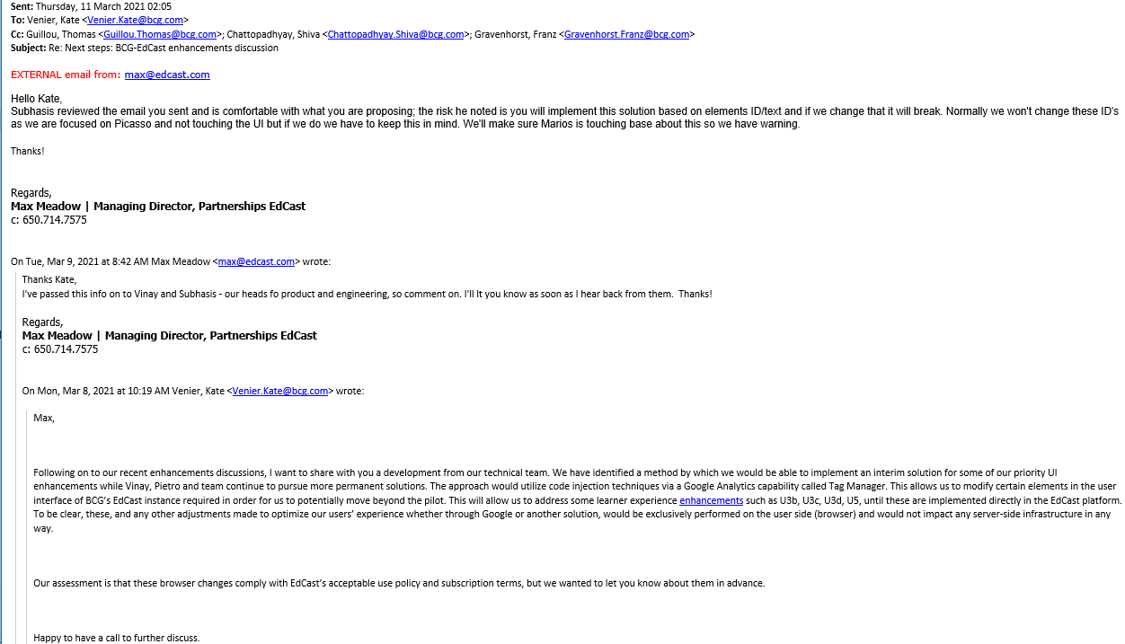
EdCast approval

Slide 7
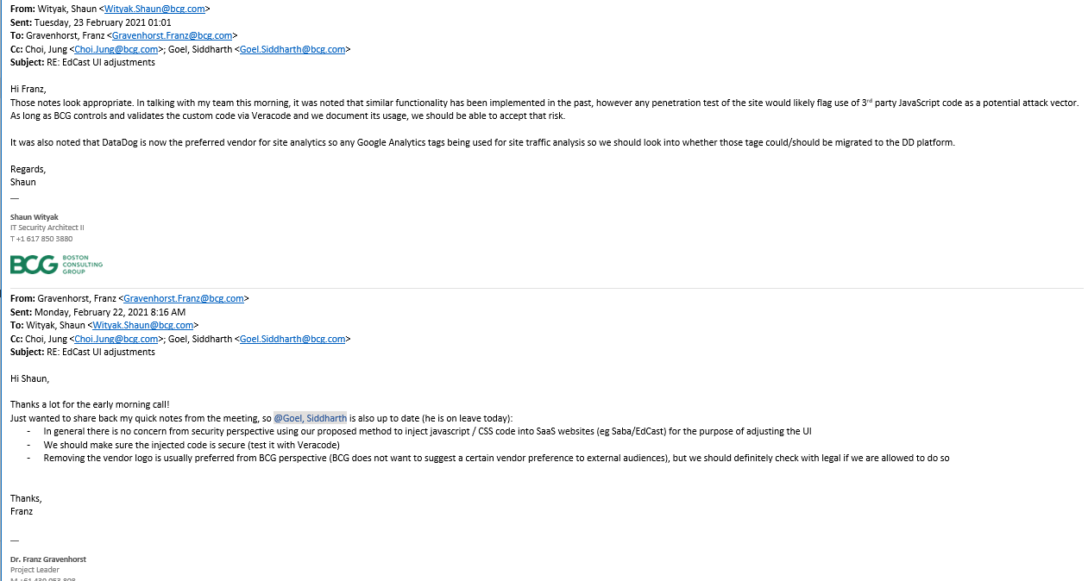
BCG security approval

Slide 8
Agenda
Why this is benefitial
Security, legal and IT assessment
How it works

Slide 9
Edit existing custom code: Overview
For new users who want to edit existing BCG assets:
1. Create a google account using your BCG email address
2. Make sure 2-factor-auth is switched on for your google account (this is a requirement from BCG side), check here: https://myaccount.google.com/security
3. Ask Freddie Winter to give you privileges to access the existing BCG containers (for EdCast Sandbox, EdCast Production, Saba Sandbox, Saba Production) in google tag manager (GTM) or ask him to create a new container (if this is for a new site): https://tagmanager.google.com
4. Log into google tag manager and select the container you want to edit
5. Within the container, select the tag you want to edit (the one with the custom code)
For Saba there is also an alternative to google tag manager:
Instead of hosting your custom HTML on GTM, you can also paste it directly into the GTM input box in Saba admin.

Slide 10
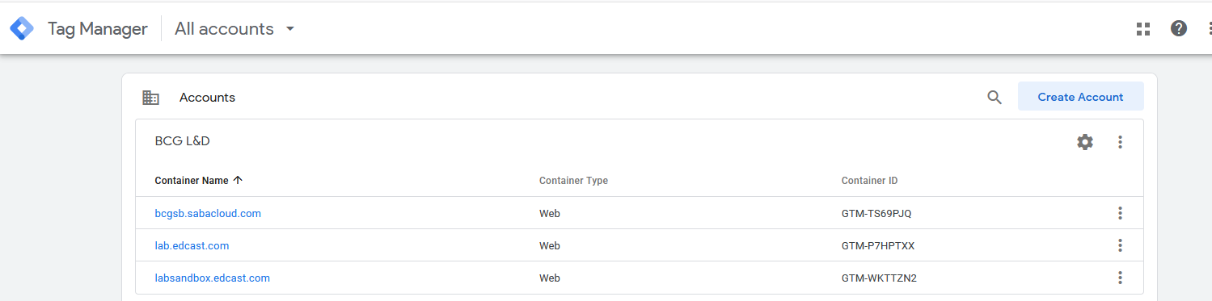
Google Tag Manager: Each site has a container within the BCG L&D account

Slide 11
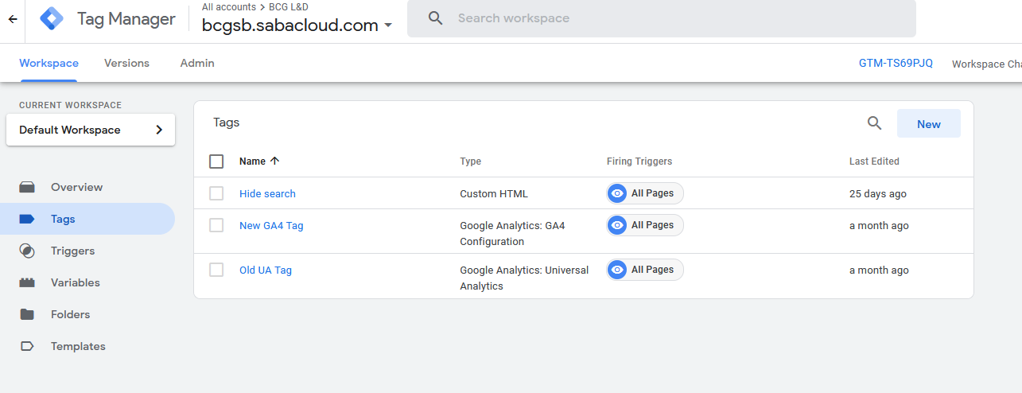
Google Tag Manager: Use the "Custom HTML" tags to insert your code

Slide 12
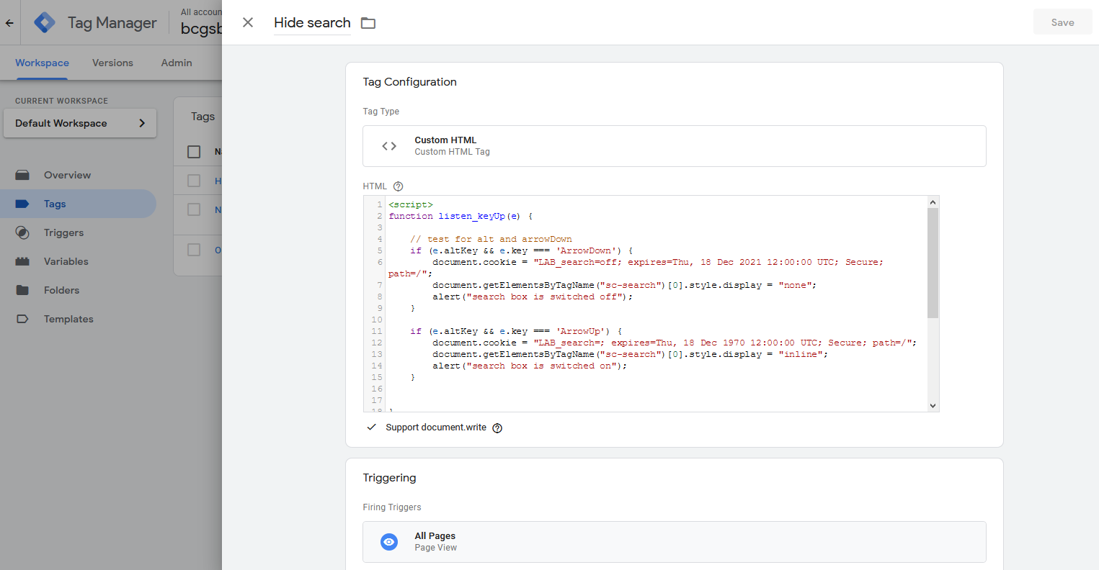
Google Tag Manager: Edit code and make sure trigger is set to "All Pages"

Slide 13
Example code for Saba: Hide Search box
<script>
function listen_keyUp(e) {
// test for alt and arrowDown
if (e.altKey && e.key === 'ArrowDown') {
document.cookie = "LAB_search=off; expires=Thu, 18 Dec 2021 12:00:00 UTC; Secure; path=/";
document.getElementsByTagName("sc-search")[0].style.display = "none";
alert("search box is switched off");
}
if (e.altKey && e.key === 'ArrowUp') {
document.cookie = "LAB_search=; expires=Thu, 18 Dec 1970 12:00:00 UTC; Secure; path=/";
document.getElementsByTagName("sc-search")[0].style.display = "inline";
alert("search box is switched on");
}
}
// register the handler
document.addEventListener('keyup', listen_keyUp, false);
if (document.cookie.includes("LAB_search")) {
document.write("<style>sc-search {display: none;}</style>");
}
</script>
This code hides the Saba search bar when you hit the keyboard shortcut: Alt + ArrowDown.
At the same time it save this setting in a cookie so it remembers the setting when you refresh the site.
To deactivate the feature again press Alt + ArrowUp.

Slide 14
Example code for EdCast: Hide Assignment labels and others
<script>
function listen_keyUp(e) {
// test for alt and arrowDown
if (e.altKey && e.key === 'ArrowDown') {
document.cookie = "LAB_assign=off; expires=Thu, 18 Dec 2021 12:00:00 UTC; Secure; path=/";
var x = document.getElementsByClassName("assignment-details");
var i;
for (i = 0; i < x.length; i++) {
x[i].style.display = "none";
}
x = document.getElementsByClassName("card-std-feed-assignor");
for (i = 0; i < x.length; i++) {
x[i].style.display = "none";
}
document.getElementsByTagName("svg")[0].style.display = "none";
x = document.getElementsByClassName("card-std-tile pointer");
for (i = 0; i < x.length; i++) {
if (x[i].getElementsByClassName("card-std-locked-card position-absolute card-std-locked-card-for-other-users").length == 1) {
x[i].style.display = "none";
}
}
alert("test mode switched on");
}
if (e.altKey && e.key === 'ArrowUp') {
document.cookie = "LAB_assign=; expires=Thu, 18 Dec 1970 12:00:00 UTC; Secure; path=/";
var x = document.getElementsByClassName("assignment-details");
var i;
for (i = 0; i < x.length; i++) {
x[i].style.display = "block";
}
x = document.getElementsByClassName("card-std-feed-assignor");
for (i = 0; i < x.length; i++) {
x[i].style.display = "block";
}
document.getElementsByTagName("svg")[0].style.display = "inline";
x = document.getElementsByClassName("card-std-tile pointer");
for (i = 0; i < x.length; i++) {
if (x[i].getElementsByClassName("card-std-locked-card position-absolute card-std-locked-card-for-other-users").length == 1) {
x[i].style.display = "inline-block";
}
}
alert("test mode switched off");
}
}
// register the handler
document.addEventListener('keyup', listen_keyUp, false);
if (document.cookie.includes("LAB_assign")) {
document.write("<style>.assignment-details { display: none; } .card-std-feed-assignor { display: none; }</style>");
document.getElementsByTagName("svg")[0].style.display = "none";
}
</script>
This code hides the assignment labels from SmartCards and the EdCast logo when you hit the keyboard shortcut: Alt + ArrowDown.
At the same time it save this setting in a cookie so it remembers the setting when you refresh the site.
To deactivate the feature again press Alt + ArrowUp.

Slide 15
Set up custom code for new EdCast / Saba instance
The following pages describe how to set up the google tag manager in EdCast or Saba. This is obviously only needed if there is a new instance or the existing ones get a reset. For the existing instances this is already done.

Slide 16
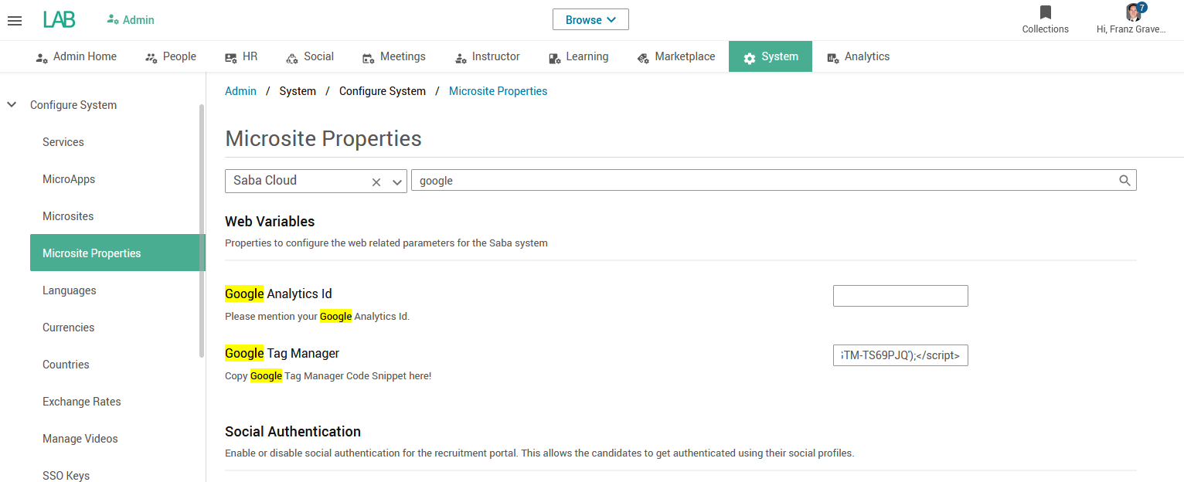
Saba setup step 1/2: Add GTM code
Input this code in the Google Tag Manager Box:
<noscript><iframe src="//www.googletagmanager.com/ns.html?id=GTM-TS69PJQ" height="0" width="0" style="display:none;visibility:hidden"></iframe></noscript> <script>(function(w,d,s,l,i){w[l]=w[l]||[];w[l].push({'gtm.start': new Date().getTime(),event:'gtm.js'});var f=d.getElementsByTagName(s)[0], j=d.createElement(s),dl=l!='dataLayer'?'&l='+l:'';j.async=true;j.src= '//www.googletagmanager.com/gtm.js?id='+i+dl;f.parentNode.insertBefore(j,f); })(window,document,'script','dataLayer','GTM-TS69PJQ');</script>
Alternatively you can also add custom HTML code directly here – instead of entering it in GTM as custom code.

Slide 17
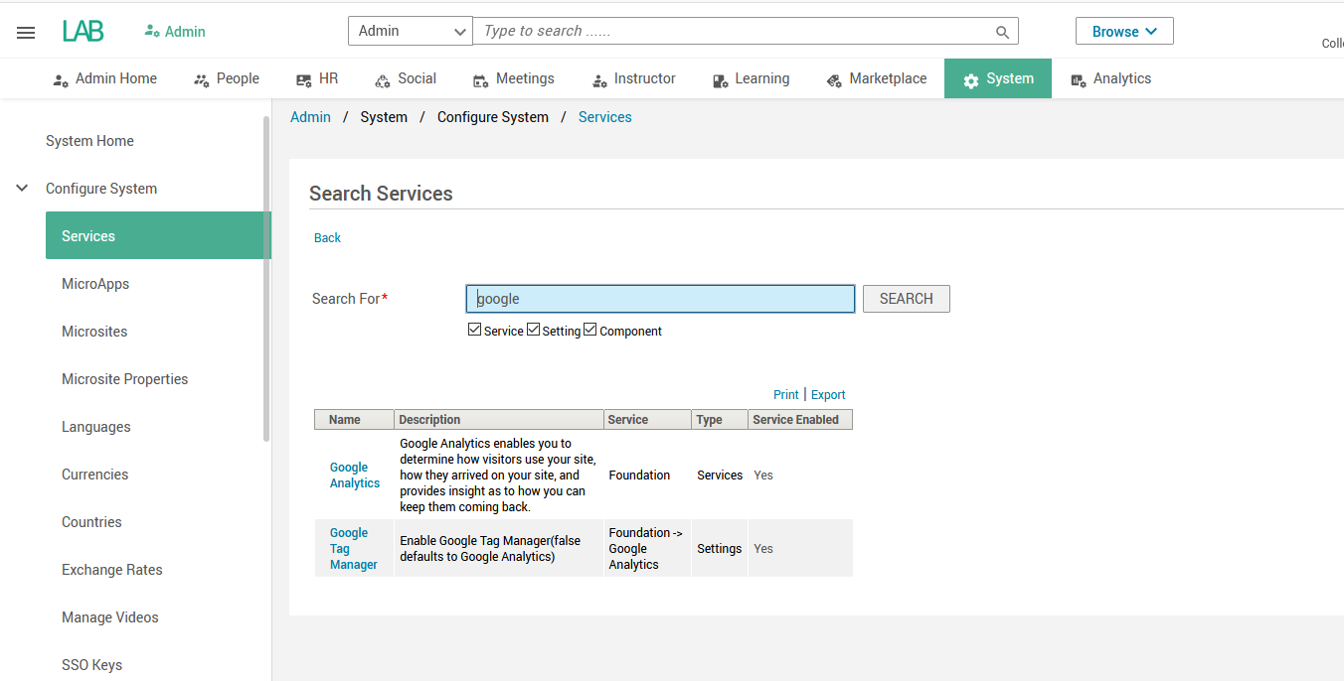
Saba setup step 2/2: Switch on GTM service

Slide 18
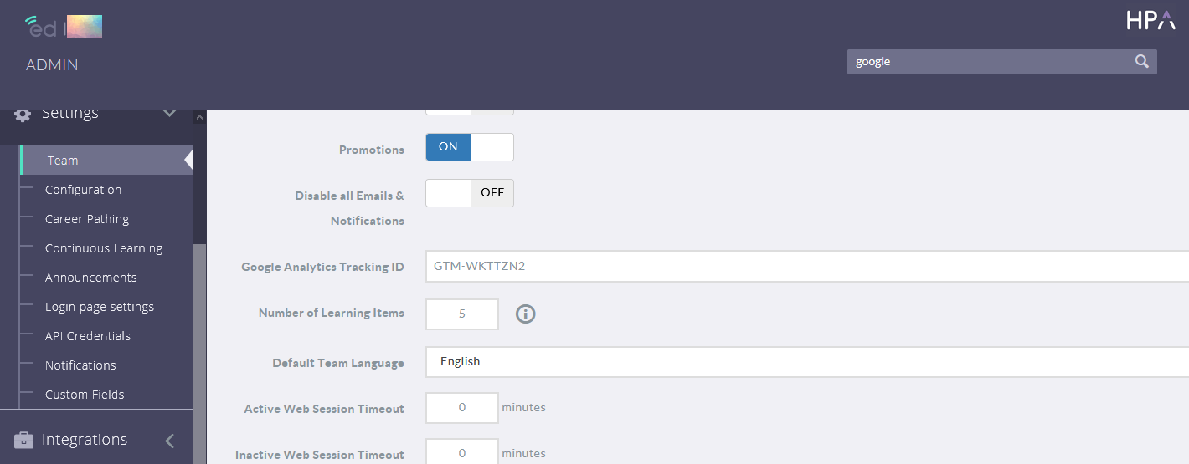
EdCast setup: Enter GTM ID in admin panel

Slide 19
Unused Slides

Slide 20
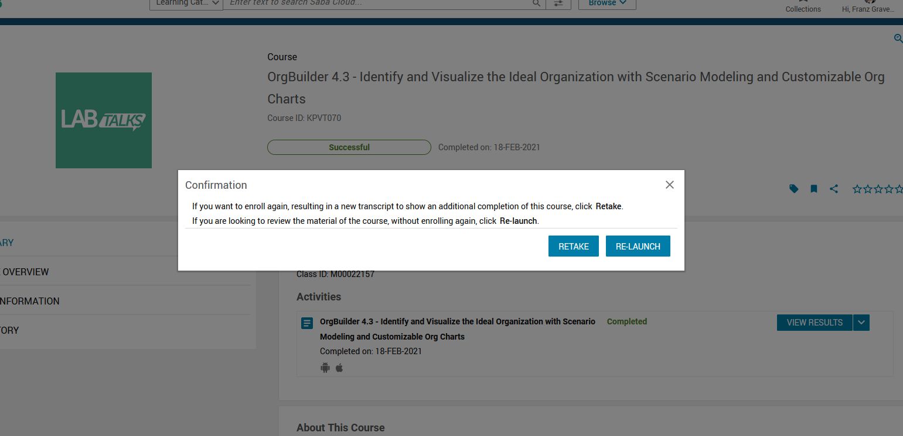
Deeplink function – now Saba also delivered!

